Slide 1
Remote Sensing of Bark Beetle Outbreak
Maggie Church
Group 16

Slide 2
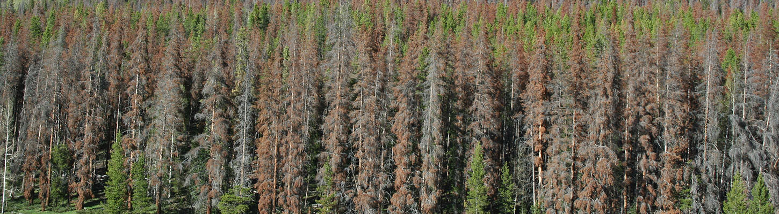
Motivation
Objective: classify change in lodgepole pine forest health after Mountain Pine Beetle (MPB) outbreak in West RMNP
Treatment: time
Notes:
There are existing data products
Aerial Detection Survey from the Forest Service
Kyle Rodman: RS study using Landsat
But they weren’t great in our study area.
Also, from a research and management perspective, it’d be valuable to map this historical disturbance. Especially since much of this area burned in 2020, obscuring beetle evidence

Slide 3
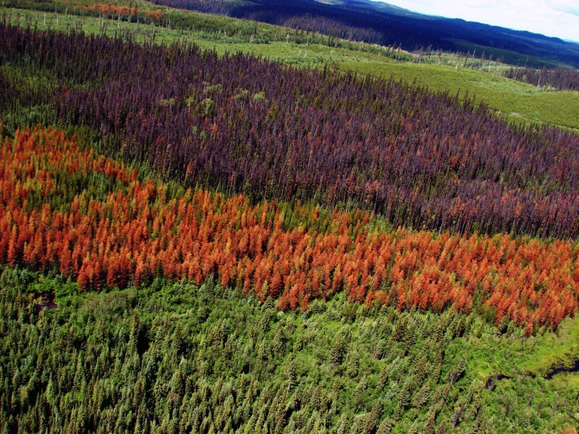
Background Info
2010: Revegetation
2001: MPB first detected in study area
2006-2008: Peak outbreak
“Red stage” 1-2 years after outbreak
“Grey stage” 3-7 years after outbreak
Bark beetle outbreak doesn’t affect the landscape simultaneously
Notes:
MPB didn’t affect the area uniformly over time
Red Stage in first summer after infestation - needles turn red

Slide 4
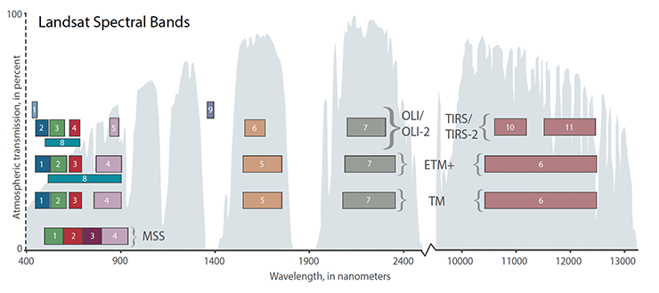
Imagery
Landsat 7 ETM+
30m resolution
16 day return
1999 - present (scan
line error in 2003)
Notes:
Based on the timeline, I coulda used Landsat 5 or 7, especially because the SLE didn’t affect my ROI. Temporal, spatial, and spectral resolutions are really similar. But 7 has higher radiometric resolution (ultimately allows a more accurate % reflectance)
(L7 is in the middle, L5 on the bottom)

Slide 5
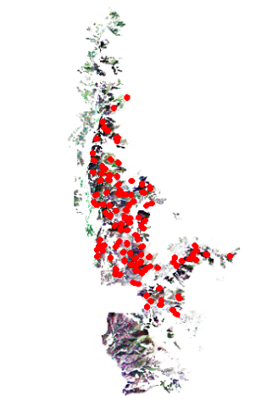
Ground Truth Data
219 field points
2015
Severity: percent basal area dead or having evidence of MPB infestation
K-mean clustering:
107 “high” (> 80%)
83 “medium” (60-80%)
29 “low” (< 60%)
Notes:
% basal area: sum of tree diameters within a plot

Slide 6
Workflow
Evaluate Landsat 7 images for cloud and snow cover
Run a supervised classification: random forest
Evaluate classification results: confusion matrix
Download Collection 2, Level 2, Tier 1 SR images
Calculate dNDMI
Predict over PICO forest type
Public-nps.opendata (2019, polygon)
Subset images to Western RMNP
Public-nps.opendata
+ maps.princeton.edu
Extract band values to ground truth points, method=bilinear
plot
Reproject to NAD83 UTM Zone 13, stack and scale/offset
Mask out Clouds, using QA_Pixel raster
Bilinear interpolation
Notes:
First: earth explorer
Red = R
Bc the plots are 20m squares and aren’t centered on landsat pixels, I used bilinear interpolation to assign spectral values to field data (I’ll explain more in next slide)

Slide 7
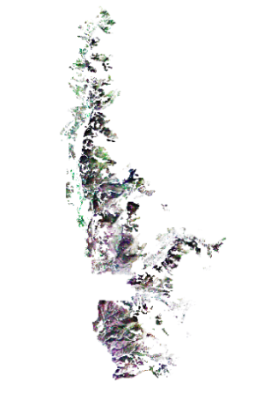
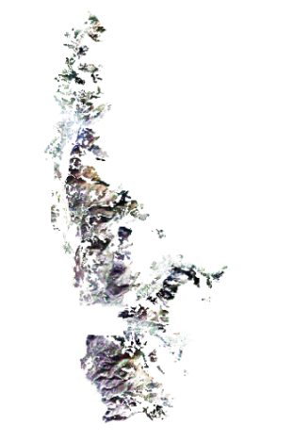
Area of Prediction: 102 km²
8/2/1999
9/17/2010
<- True Color
99% cloud-free
100% cloud-free
Notes:
True color images

Slide 8
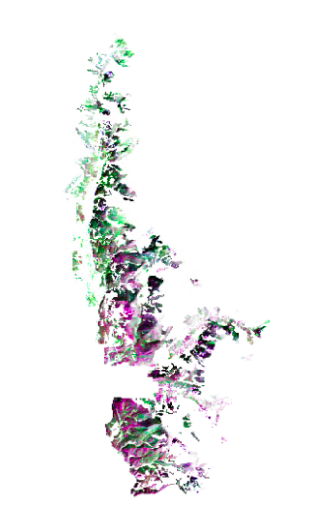
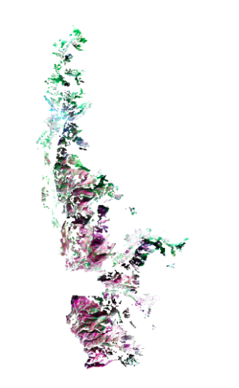
8/2/1999
9/17/2010
<-
False color
R = SWIR1
G = NIR
B = Green
Vegetation should appear bright green.
Notes:
Subtle differences

Slide 9
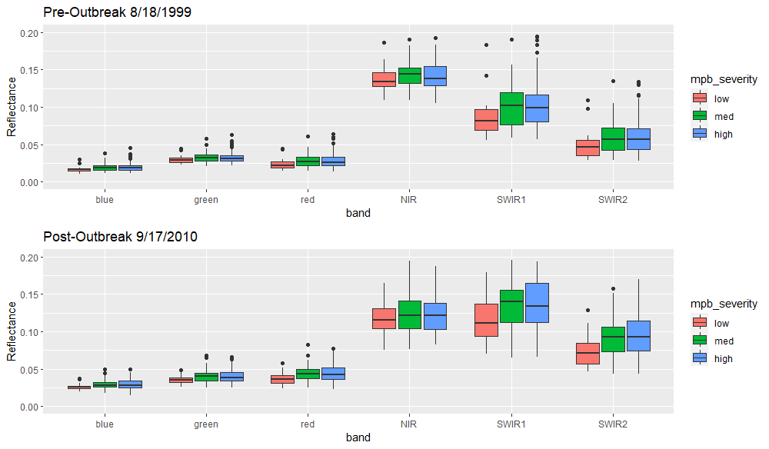
Spectral Signatures
Notes:
Based on how we classified them using field data
Notice how you start to see classes forming in the pre-outbreak image, especially in the SWIR bands. MPB outbreaks are known to sort of “begin” with drought-stressed trees bc they’re easy targets - high/med classes might have had less leaf water content before the outbreak
The post image is a bit higher in blue, green, red. It’s quite a bit lower in NIR and higher in SWIR. (interpret…). The problem is that the shifts sort of move linearly between classes

Slide 10
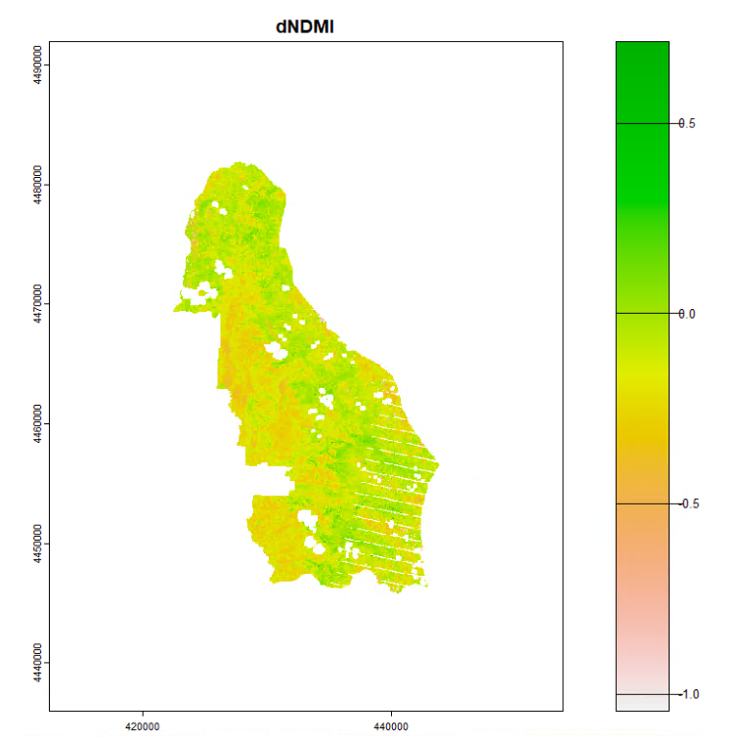


Model
NDMI: Normalized Difference Moisture Index
…sensitive to leaf moisture content
Training set: random sample of sites - 70%
Notes:
NDMI is using for detecting bark beetle in the literature.

Slide 11

Accuracy
Confusion Matrix - Testing Data
Testing accuracy:
Overall: 42%
Sensitivity: 34% - true positives
Specificity: 67% - true negatives
 | Commission Accuracy | Omission Accuracy
high | 25% | 10%
med | 25% | 41%
high | 59% | 51%
Notes:
Accuracy using testing data.
Relatively better at predicting high classes

Slide 12
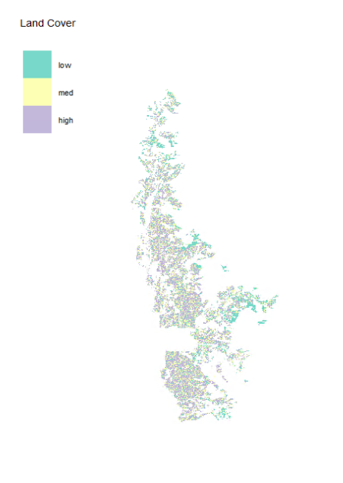
Land Cover Prediction
Low: 21% (21 km²)
Med: 30% (31 km²)
High: 49% (50 km²)

Slide 13
Discussion
Ideas for improvement
LandTrendR
hyperparameter optimization
XGBoost
Finer spatial resolution
Non-random testing/training split
Is this useful?
Not really
Differentiation in the pre-outbreak image SWIR bands
Hypothesis 1: MPB tends to attack drought-stressed trees. High/med classes might have had a lower leaf water content before the outbreak.
Hypothesis 2: MPB also tends to attack stands with larger basal areas. High/med classes might have been in high-diameter, self-thinned stands, therefore appearing drier.
Notes:
LandTrendR is a multi-temporal algorithm that was designed to detect rapid change, used for detecting disturbance
Why use XGBoost - RF tends to overtrain, XGBoost does a better job avoiding the noise
I was honestly surprised that this didn’t perform very well. Shows how hard this is, and why those layers didn’t perform well.
Differentiation in the pre-outbreak image is interesting in itself

Slide 14
References
Carlson, A. R., Sibold, J. S., Assal, T. J. & Negrón, J. F. Evidence of compounded disturbance effects on vegetation recovery following high-severity wildfire and spruce beetle outbreak. PLoS ONE 12, e0181778 (2017).
Meng, R. et al. Landsat-based monitoring of southern pine beetle infestation severity and severity change in a temperate mixed forest, Remote Sensing of Environment, 269 (2022).
Perovich, C. & Sibold, J. S. Forest composition change after a mountain pine beetle outbreak, Rocky Mountain National Park, CO, USA. Forest Ecology and Management 366, 184–192 (2016).
Rodman, K. C. et al. Effects of Bark Beetle Outbreaks on Forest Landscape Pattern in the Southern Rocky Mountains, U.S.A. Remote Sensing 13, 1089 (2021).
Vorster, A. G. et al. Severity of a mountain pine beetle outbreak across a range of stand conditions in Fraser Experimental Forest, Colorado, United States,
Forest Ecology and Management, 389, 116-126 (2017).
Walter, J. A. & Platt R. V. Multi-temporal analysis reveals that predictors of mountain pine beetle infestation change during outbreak cycles, Forest Ecology and Management 302, 308-318 (2013).

